Slide 1

CS360 Project
Michael Kelnar, Michael Joson, Samhita Achanta, Srushti Desai

Slide 2
Problem presentation
The dataset we chose is ‘Spotify Weekly Top 200 Songs Streaming Data’ which includes the Top 200 songs on Spotify by country from 2021/02/04 ~ 2022/07/14
https://developer.spotify.com/documentation/web-api/reference/#/operations/get-several-audio-features : Spotify has audio features associated with all the songs on the platform which includes instrumentalness, danceability, and much more. Using these features we will try to predict the streams that a song will achieve.
Dataset contained 1787531 rows x 28 columns
Notes:
Our group decided to choose the Spotify 'Weekly Top Songs' dataset which charts the top 200 songs for each country from the week of 2021/02/04 ~ 2022/07/14. For the 'Global' charts, there is data going back to the year 2016. The dataset rows are the songs while the columns show different attributes such as number of streams, rank, and spotifies audio features. The spotify audio features are assigned to each song and includes instrumentalness, danceability, acoustic ness and more to describe each song uniquely. Our goal using this dataset is to predict weather a song will surpass a certain amount of streams according to these features.

Slide 3
Related work
https://research.atspotify.com/machine-learning/ : How Spotify uses machine learning in house to continually improve the software.
https://www.kaggle.com/code/nirvanadosco/notebook78264f155c : A Kaggle user by the name of ‘nirvana’ research on the dataset.
https://towardsdatascience.com/predicting-popularity-on-spotify-when-data-needs-culture-more-than-culture-needs-data-2ed3661f75f1 : Similar study which examines popularity instead of streams.
https://medium.com/analytics-vidhya/spotify-music-data-analysis-part-4-4016e2954795 : Clustering approach to the spotify dataset.
https://public.tableau.com/app/profile/yejielee/viz/TheModernARExperienceWhichGlobalArtistWillYouSign/ar_dashboard : dashboard created using the dataset.
https://medium.com/@yejie1999/selling-culture-k-pop-reggaeton-and-afrobeats-c990908bf01b : research done on the dataset by the dashboard creator.
Notes:
Some related work that we were able to find with our dataset and ones that are similar include first and foremost spotify's own machine learning research that is done to improve the spotify software. “It is used to help listeners discover content via recommendations and search, generate playlists, extract audio content-rich signals for cataloging and other content-based applications, understanding voice commands, serve ads, develop business metrics and optimization algorithms, create music with AI-assisted tools, and more.” Next we found a user on Kaggle posted some of his own research done on the dataset. The dataset originally was used to create a dashboard by a user that goes by ‘Culture Jockey’. Using the dashboard you can explore artists and music trends around the world. Some of ‘Culture Jockey’s findings are featured on medium.com. Lastly we have some similar research done in regards to predicting popularity. Many of the same techniques and algorithms are used.

Slide 4
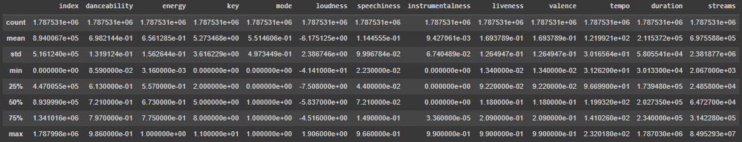
Data handling
top 10% is streams >1000000, top25% is >325000 so we changed our target data of streams to be a binary value of either 0 or 1, weather a song is or is not in the top 25% of streams
0 1351665 - Top songs less than 25% of streams
1 435866 - Top songs more than 25% of streams
Mean. min, max of all important features shown in the table
Median streams: 64727.0
Notes:
We transformed the streaming column, our target value, to be represented as either a 0 or 1 weather the track was able to achieve top 25 % of streams which in our dataset is over 325,000 streams.

Slide 5
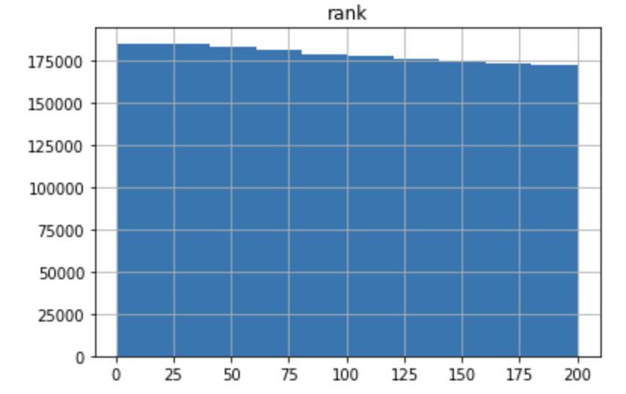
Our Features
0 rank float64
1 artist_names object
2 artists_num float64
3 artist_genre object
4 collab float64
5 track_name object
6 release_date object
7 album_num_tracks float64
8 peak_rank float64
9 previous_rank float64
10 weeks_on_chart float64
11 streams float64
12 week object
13 danceability float64
14 energy float64
15 key float64
16 mode float64
17 loudness float64
18 speechiness float64
19 acousticness object
20 instrumentalness float64
21 liveness float64
22 valence float64
23 tempo float64
24 duration float64
25 country object
26 region object
27 language object
Notes:
These are all 28 of the features present in our dataset before dropping any. Besides the spotify audio features which will be mentioned shortly, there are features such as weeks_on_chart, language, country, and many more.

Slide 6
Features we dropped
'Unnamed: 0'
'source'
'uri'
'artist_id'
'artist_img'
'album_cover'
'artist_individual'
'pivot'
Notes:
The following are the features we chose to drop from the dataset. We chose to drop these due to NULL and missing values and because some of the columns are irrelevant and could mess with the rest of the data in predicting streams such as artist_img or album_cover.

Slide 7
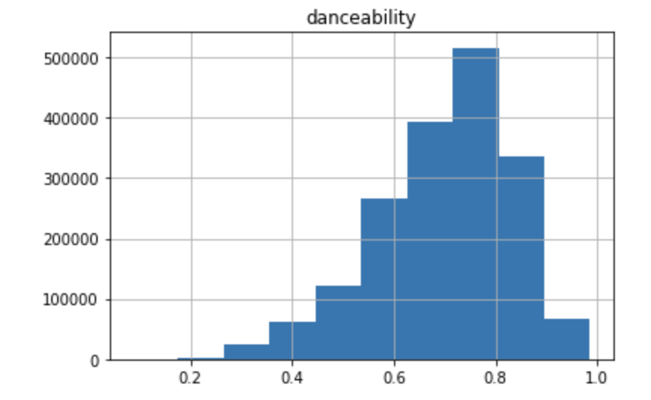
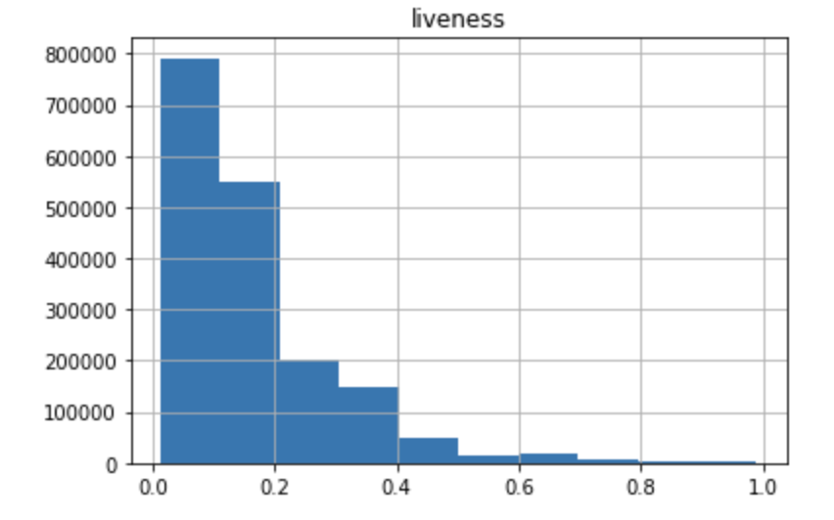
Audio Features
'danceability'
'energy'
'key'
'mode'
'loudness'
'speechiness'
'acousticness'
'instrumentalness'
'liveness'
'valence'
'tempo'
'duration'
'streams'
Notes:
These are the spotify audio features assigned to each track. Looking at danceability for example, Danceability describes how suitable a track is for dancing based on a combination of musical elements including tempo, rhythm stability, beat strength, and overall regularity. A value of 0.0 is least danceable and 1.0 is most danceable. Using these features we will try to predict weather a song will reach the top 25 % of streams.

Slide 8
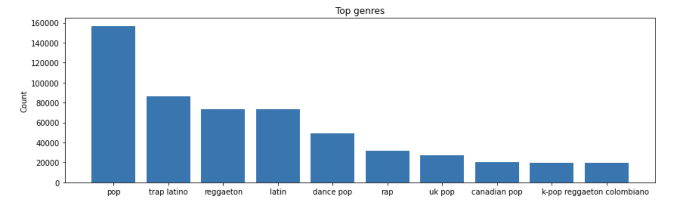
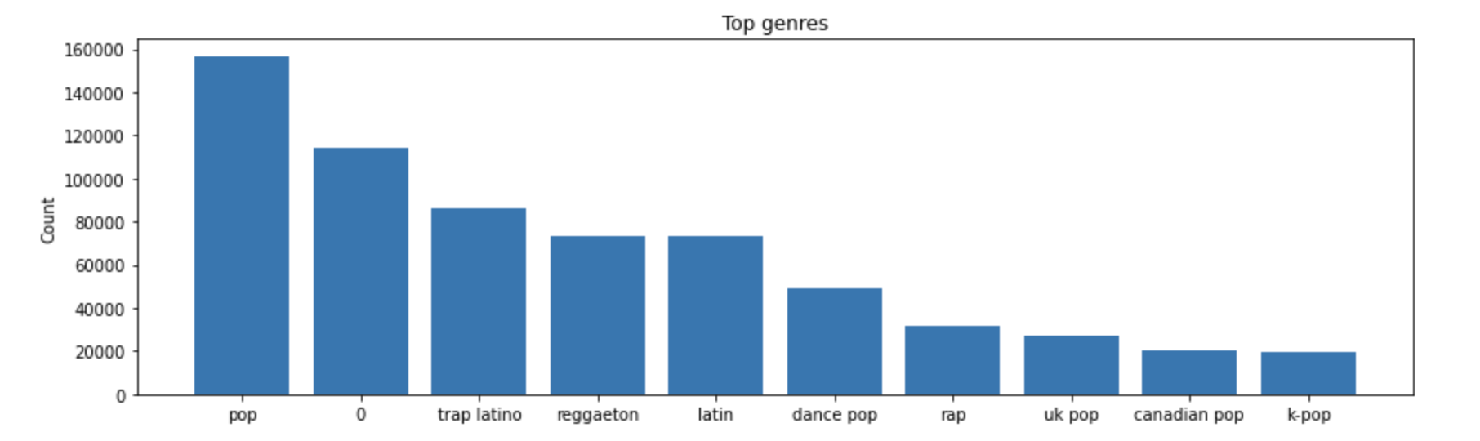
Top 10 Genres
Notes:
These are the Top 10 genres. The first graph shows the genres excluding rows where it was null which is identified as “0”.
Pop genre makes up most of the songs, followed by trap latino and reggaeton&latino

Slide 9
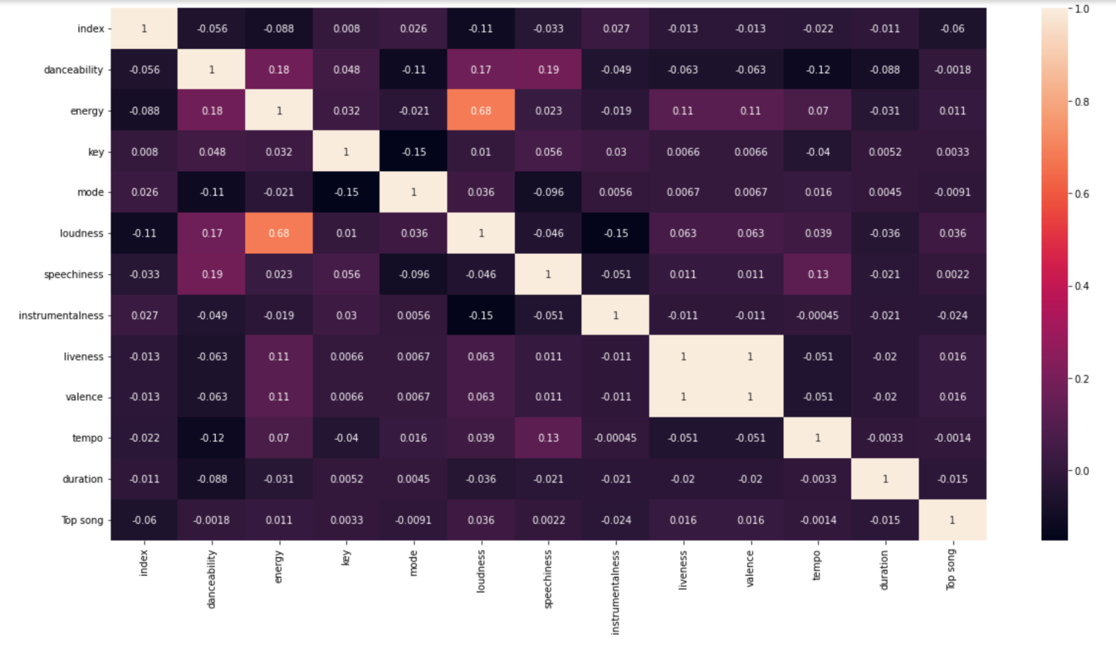
Audio Feature Correlation
Notes:
Here is a correlation heatmap of how the spotify audio features relate to one another and to being a top streaming song.

Slide 10
Predictions
Notes:
Next we will look at all the predictions we ran on the dataset.

Slide 11
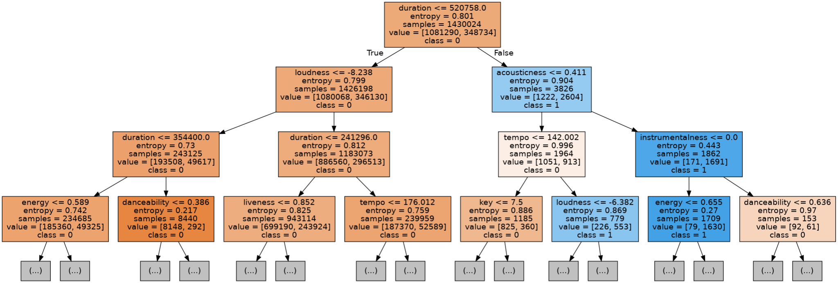
Decision Tree Classification
Used Cross validation to find optimal depth
Notes:
The first classifier and prediction model that we tried on our dataset is Decision tree classification. We implemented cross validation to determine the optimal depth for the tree which turned out to be 12 and built our model on entropy. The accuracy we achieved using Decision tree classification was 76.7%.

Slide 12
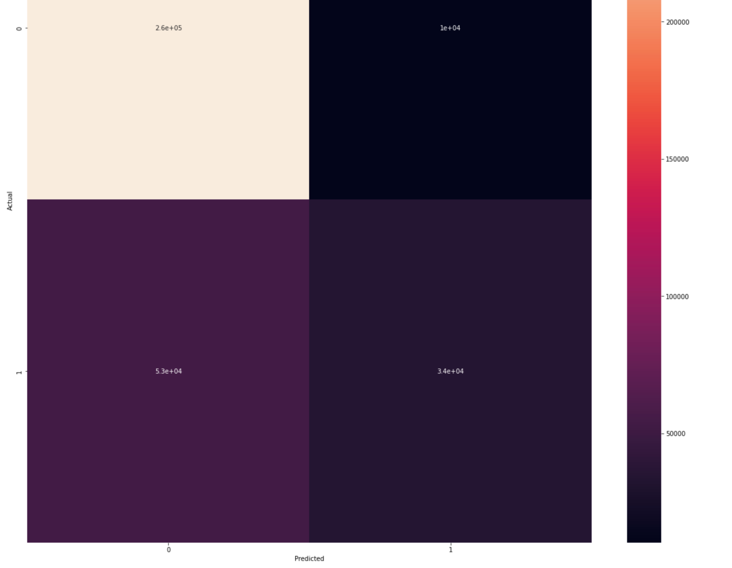
KNN
Used cross validation to find optimal number of neighbors: n = 6
Obtained an accuracy of 82.2%
One of our slowest algorithms
Notes:
Next we implemented K nearest neighbors (KNN). We also used cross validation here to find the optimal number of neighbors which was n = 8. We achieved a higher accuracy here of 82.2% however it was one of our slowest algorithms to compute.

Slide 13
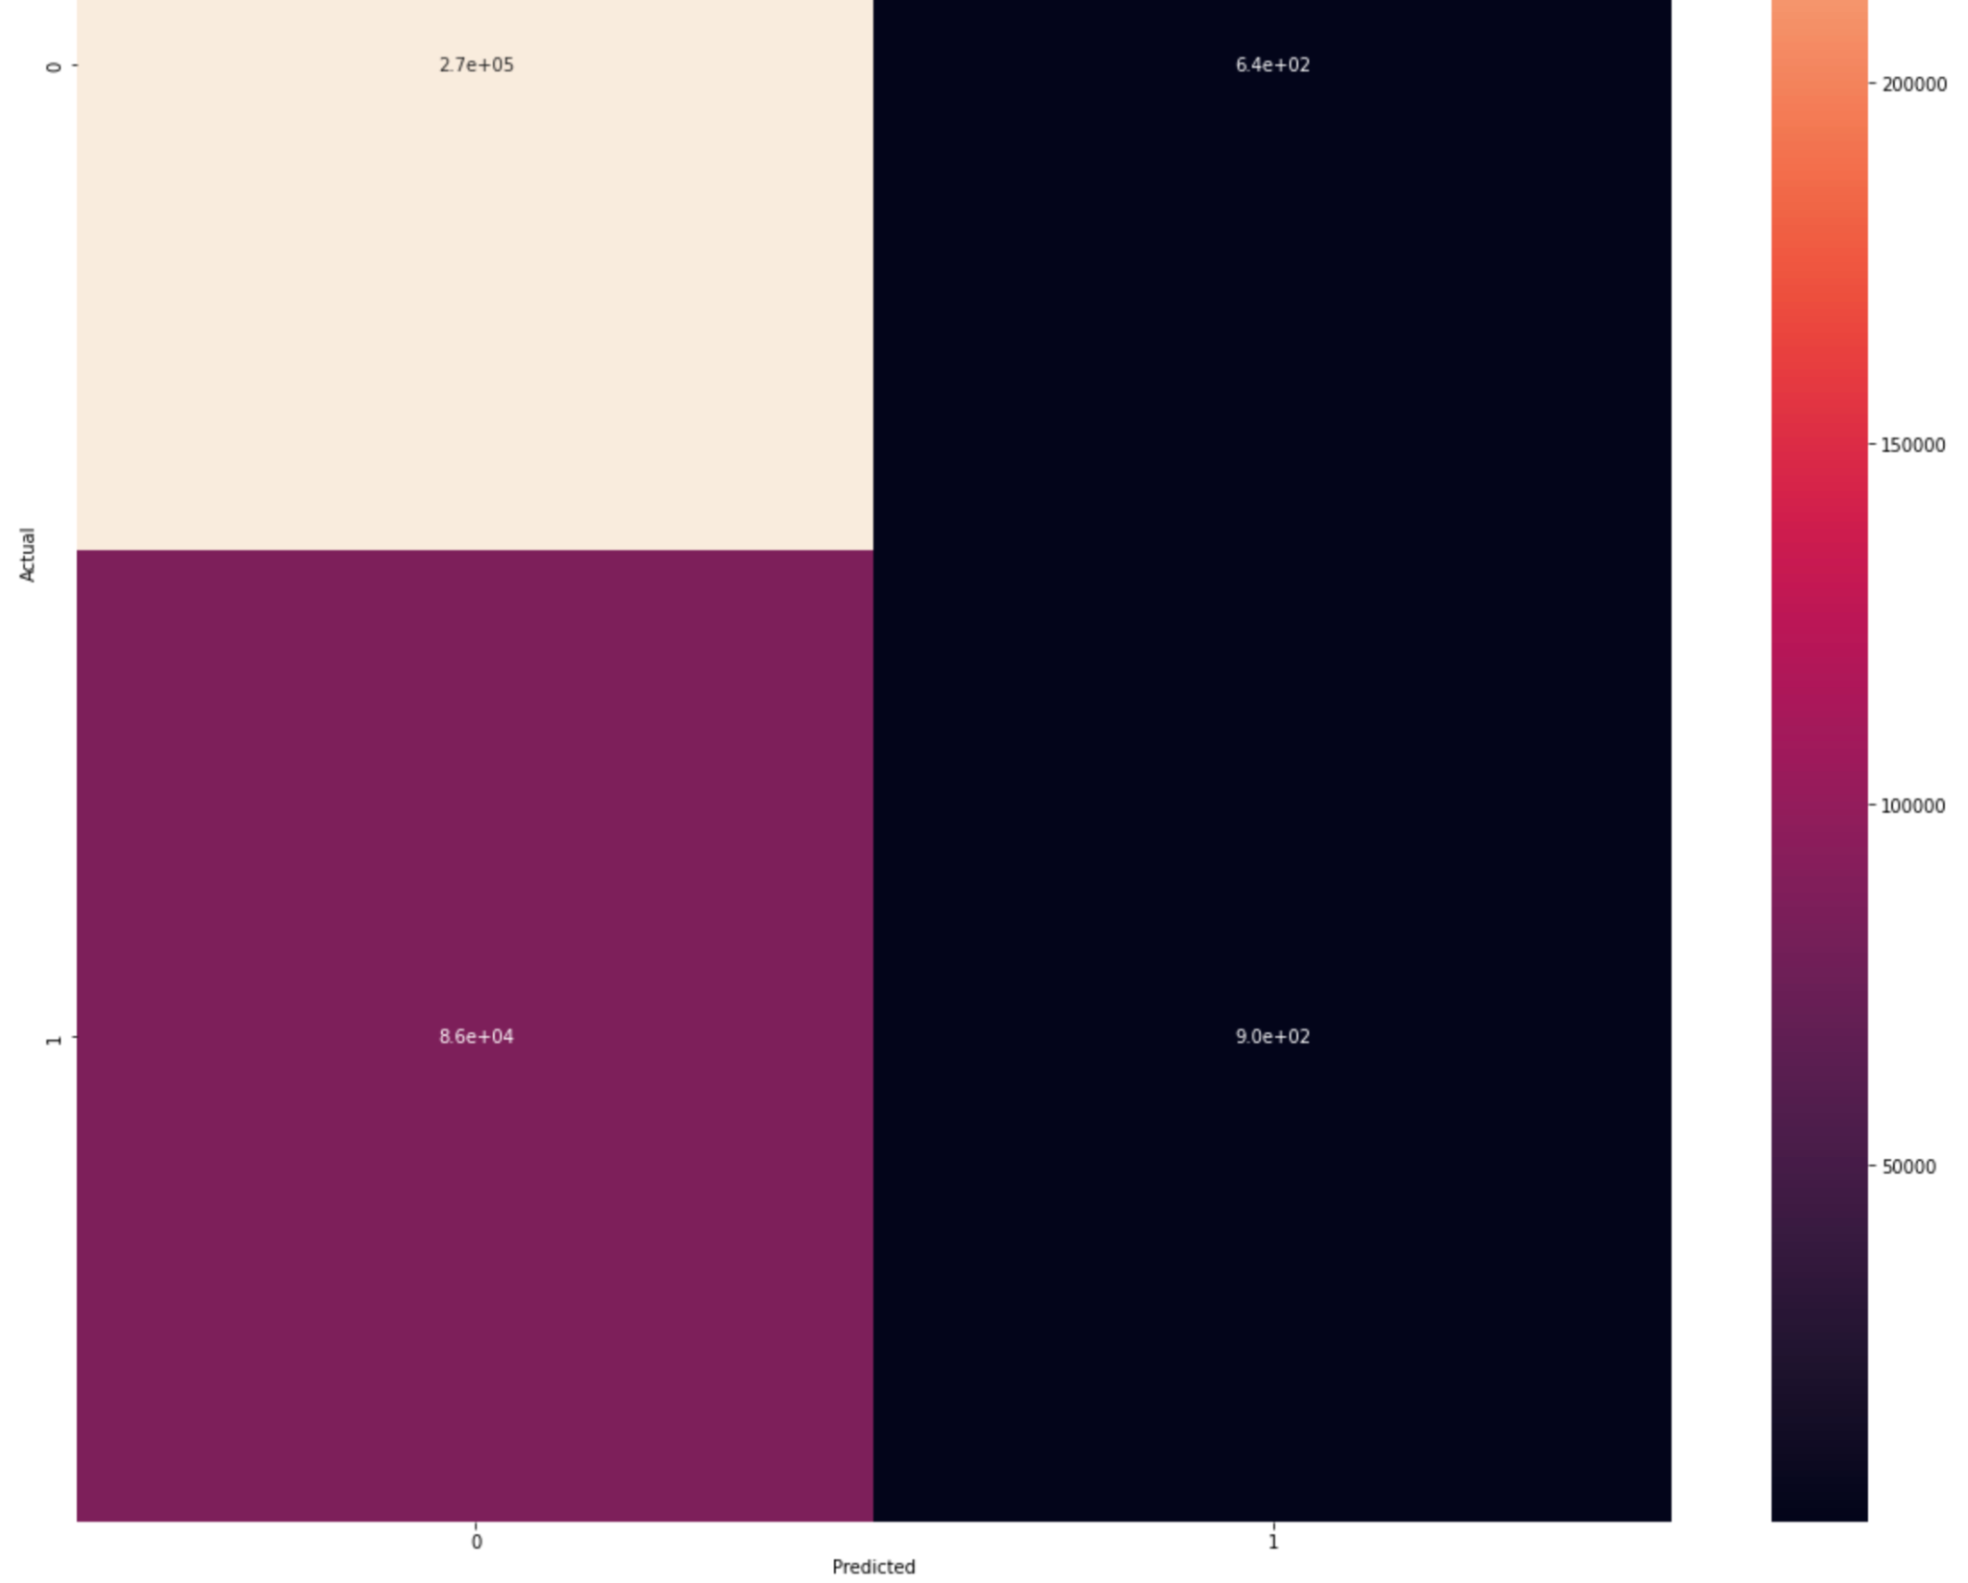
Gaussian Naive Bayes
Used default parameters
Obtained an accuracy of 75.7%
Fastest algorithm
Gaussian (continuous values)
vs Multinomial (discrete)
Notes:
Gaussian Naive Bayes model is what we tried next on our dataset. Using the default parameters, we were able to achieve an accuracy of 75.7%. While not the most accurate it was the fastest algorithm that we used.

Slide 14
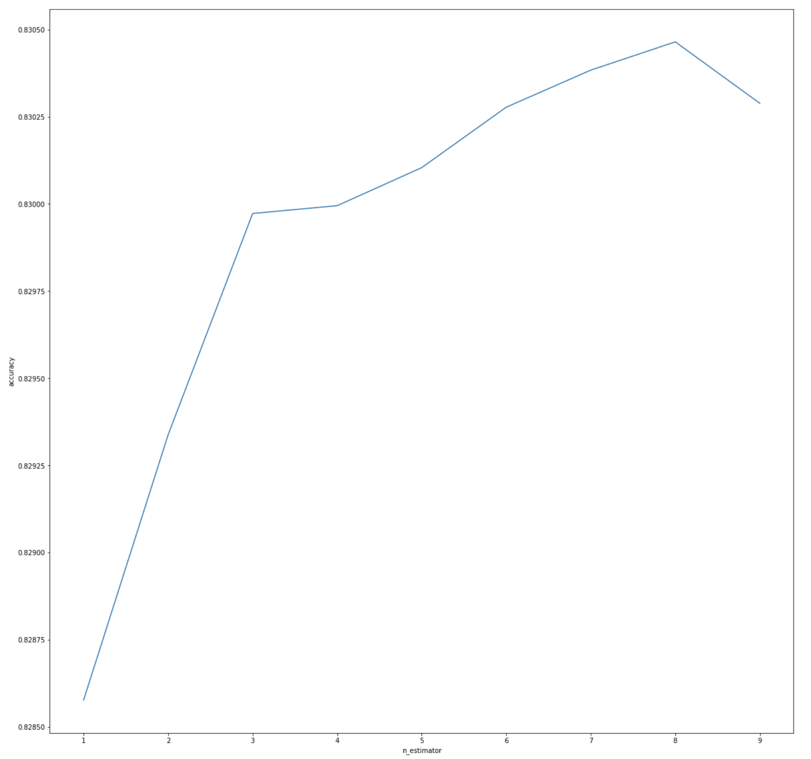
Random Forest
Used the same best depth as our decision tree classifier which was 12
Tuned n_estimators to find the best value for n_estimators being 8
Obtained an accuracy of 83.05%
Notes:
Next we implemented the Random Forest model. Being similar to a decision tree classifier we used the same best depth of 12 in our implementation.

Slide 15
Gradient Boosting
What is gradient boosting?
Combines weak learners (decision trees) to create stronger models by trying to reduce errors from the previous tree
Algorithm
Start by calculating average value for the target
Calculate the residuals = actual - average (distance from point to the line)
Build a tree for the residuals
Predict the target from the residual tree
Make new residuals = actual - predicted values from previous
Repeat until # of trees is reached
Do final predictions
Use the learning rate to reduce overfitting - ours was 0.3
Used cross validation to determine optimal depth of 4
Accuracy: 82.93% (but slowest time)
Notes:
Boosting is a special type of Ensemble Learning technique that works by combining several weak learners(predictors with poor accuracy) into a strong learner(a model with strong accuracy). This works by each model paying attention to its predecessor’s mistakes. In Gradient Boosting, each predictor tries to improve on its predecessor by reducing the errors. But the fascinating idea behind Gradient Boosting is that instead of fitting a predictor on the data at each iteration, it actually fits a new predictor to the residual errors made by the previous predictor. Learning rate slows down the learning. Once again we used cross validation in our implementation to find the optimal depth which was 4. Overall we obtained an accuracy of 82.93%, our best performing but slowest model.

Slide 16
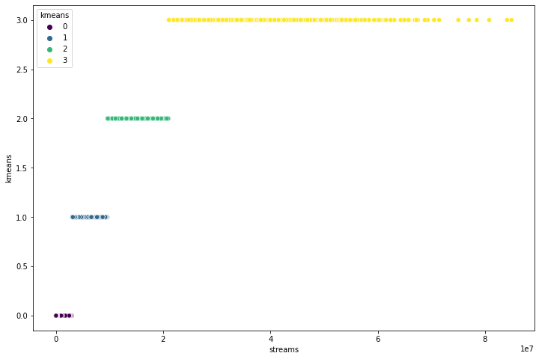
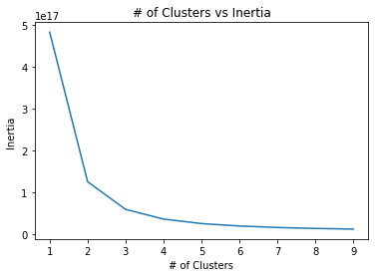
KMeans Clustering
Created an elbow graph to find the optimal # of clusters = 4
Inertia measures how well the data was clustered
A good model is one with low inertia and low clusters
Cluster 0: 194187
Cluster 1: 202815
Cluster 2: 195238
Cluster 3: 208655
Notes:
Lastly we implemented KMeans clustering. First we created an elbow graph to determine the optimal number of clusters for the model which was 4. In clustering, inertia is the measurement of how well the data was clustered. Typically a good model is one with low inertia and low clusters. Cluster 3 had the most similar songs together.

Slide 17
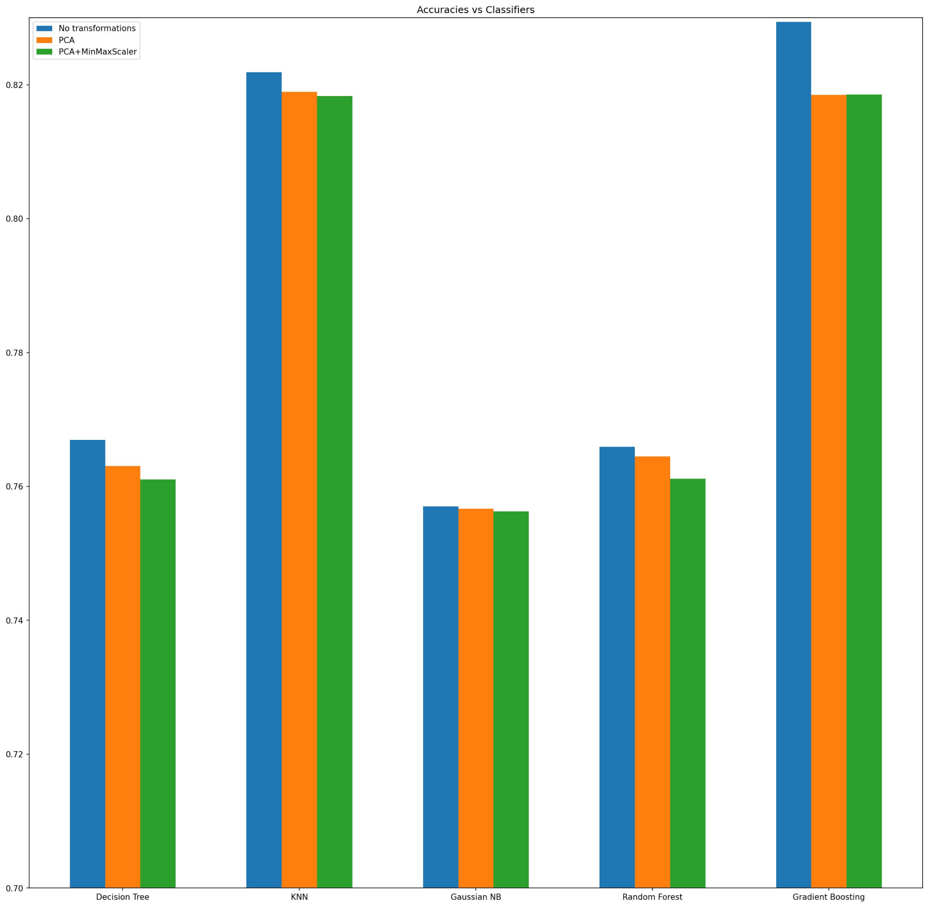
Accuracies with different transformations
Notes:
PCA transformed dataset from 13 to 2 dimensions

Slide 18
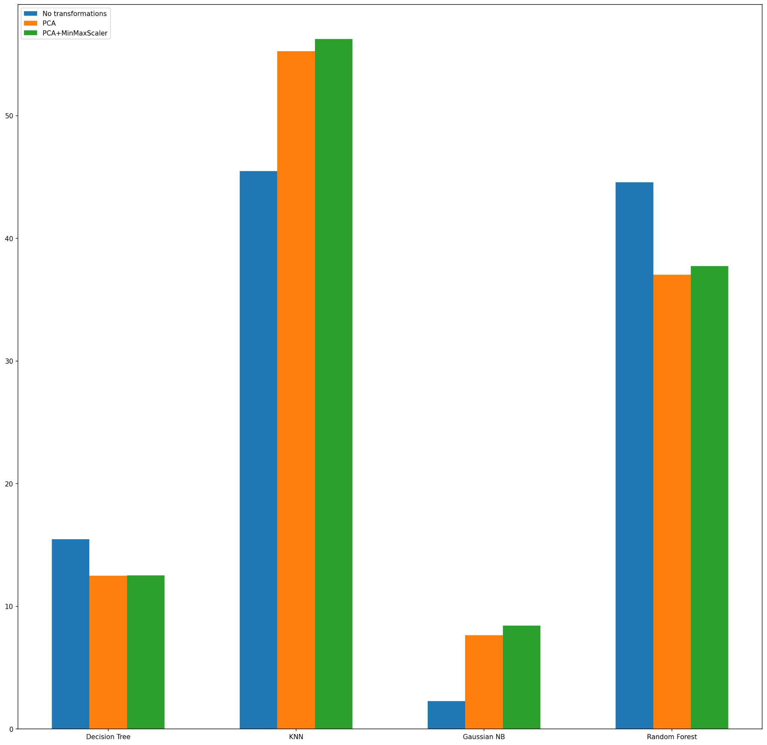
Times with different transformations
Note: Time for Gradient Boosting too large to be shown (21.55 minutes long)

Slide 19
Conclusion
Our fastest algorithm was: Gaussian Naive Bayes
Our highest accuracy algorithm was: Gradient Boosting
Our best overall algorithm: KNN + PCA
Our worst overall algorithm: Gaussian Naive Bayes with PCA and MinMaxScaler
Notes:
What are the key takeaways for your project?
What could you have done better?
What would you have explored with more time?
Did you answer the questions you set out to answer? Did new questions arise in the middle of your project?

Slide 20
Conclusion cont.
Key takeaways:
Spotify audio features by themselves have little correlation to the success (streams) a song will achieve however we were able to build models that through different techniques was able to achieve our highest accuracy of 82.93%.
Given more time it would be beneficial to explore different factors such as country and what probability a certain song will perform well there will show.
Several questions arose such as what external factors may play a role in a songs number of streams such as:
Is the song tik tok famous?
Is the artist signed to a record label?
What is the artists social media following?
Notes:
What are the key takeaways for your project?
What could you have done better?
What would you have explored with more time?
Did you answer the questions you set out to answer? Did new questions arise in the middle of your project?

